Slide 1
Coverage
Devops overview
Version control using git
Build Maven
Continuous integration using Jenkins.
Automation Testing using Selenium
Containerization using docker
Monitoring

Slide 2
Git
Maven
Jenkins
Docker
Selenium
BDD

Slide 3
Agenda
what is devops
what is devops?
Devops stages?
Tools
old methodology
Let us start with watrefall model:
before devops organization was using this methodology

Slide 4
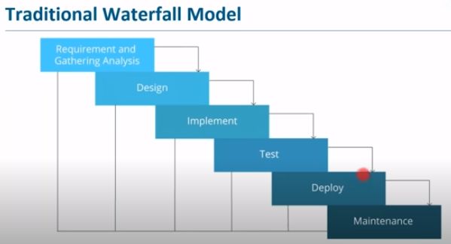

Slide 5
Build include compliation,unit testing ,packaging .
Deployed on test server for testing and then on production server for release.
After release the application is monitor.

Slide 6
Explain in brief the waterfall model.
Various stages
Linear and sequential approach

Slide 7
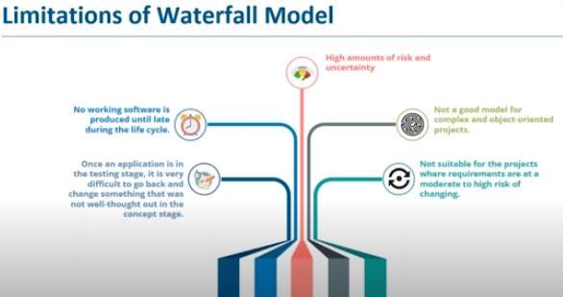

Slide 8
Difficult to do changes
Difficult to debug the the error at late stages.
Time consuming
no deliverable , it is in late stage of life cycle.
Not good for complex and object oriented project.
Chances of change in technology

Slide 9
Agile Methodology

Slide 10
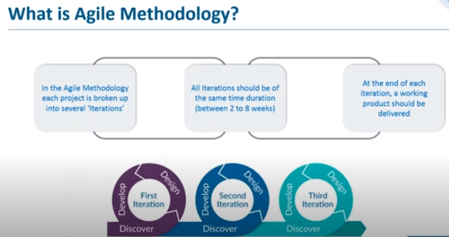

Slide 11
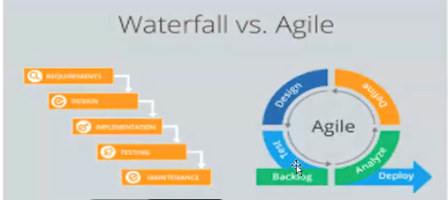

Slide 12
Analyze→plan→design→build→test→deploy
Each iteration will return deliverable product
Once the final testing is done it will be deployed in prod server.
Devlopment is continuous but deployment is not .
Deployment is linear and manual where as dev is continuous.

Slide 13
Agile
Continuous dev and testing in each iteration
Multiple iteration
Design test and build is continous
Limitation:
Dev part is agile and dynamic but the deployment is not .
Agile is linear but deployment is still linear and manual
Deployment need stability.

Slide 14
Continuous iteration of dev and testing throughtout the life cycle of soft devlopment.
Dev+testing→release of iteration (working product)

Slide 15
Solution is devops
In agile dev and testing is continuous but when we talk abt the deployment it is not continuous. For example the code working on developer laptop but not in production enviroment.
Developer wants the agility where as operation team wants stability. To overcome this devops came into picture .
ops team take care of app deployment,server maintenance,monitoring etc.

Slide 16
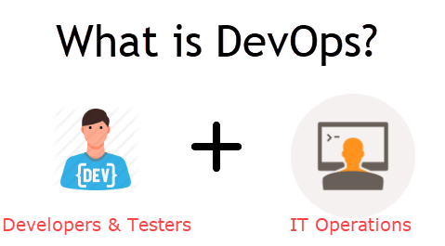

Slide 17
What is DevOps?
The DevOps is a combination of two words, one is software Development, and second is Operations.
This allows a single team to handle the entire application lifecycle, from development to testing, deployment, and operations.
DevOps helps you to reduce the disconnection between software developers, quality assurance (QA) engineers, and system administrators.

Slide 18
Why DevOps?
Before going further, we need to understand why we need the DevOps over the other methods.
The operation and development team worked in complete isolation.
After the design-build, the testing and deployment are performed respectively. That's why they consumed more time than actual build cycles.
Without the use of DevOps, the team members are spending a large amount of time on designing, testing, and deploying instead of building the project.
Manual code deployment leads to human errors in production.
Coding and operation teams have their separate timelines and are not in synch, causing further delays.

Slide 19
DevOps History
In 2009, the first conference named DevOpsdays was held in Ghent Belgium. Belgian consultant and Patrick Debois founded the conference.
In 2012, the state of DevOps report was launched and conceived by Alanna Brown at Puppet.
In 2014, the annual State of DevOps report was published by Nicole Forsgren, Jez Humble, Gene Kim, and others. They found DevOps adoption was accelerating in 2014 also.
In 2015, Nicole Forsgren, Gene Kim, and Jez Humble founded DORA (DevOps Research and Assignment).
In 2017, Nicole Forsgren, Gene Kim, and Jez Humble published "Accelerate: Building and Scaling High Performing Technology Organizations".

Slide 20
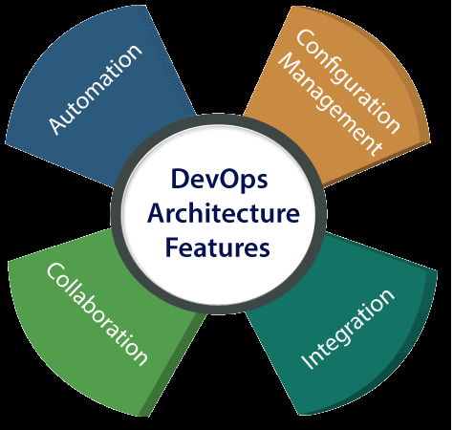
DevOps Architecture Features
Here are some key features of DevOps architecture, such as:

Slide 21
Automation
Automation can reduce time consumption, especially during the testing and deployment phase. The productivity increases, and releases are made quicker by automation
Collaboration
The Development and Operations team collaborates as a DevOps team, which improves the cultural model as the teams become more productive with their productivity, which strengthens accountability and ownership.
Integration
Applications need to be integrated with other components in the environment. The integration phase combines the new functionality and then tested. Continuous integration and testing enable continuous development.
Configuration management
It ensures the application to interact with only those resources that are concerned with the environment in which it runs. The configuration files are not created where the external configuration to the application is separated from the source code. The configuration file can be written during deployment, or they can be loaded at the run time, depending on the environment in which it is running.

Slide 22
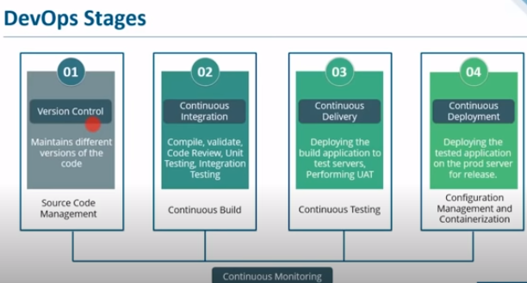

Slide 23
Version control-Git GitHub(SCM)
Integration—Jenkins, Building code is not only involved compilation, but it also includes unit testing, integration testing, code review, and packaging.
Continuous Delivery (continuous testing)—once the build is done jenkins will deploy the app on test server, for unit testing ,UAT, functional once done
Continous Deployment (Configuration mgt and containerization)—tested build will be deployed on prod server,maven ,gradle,

Slide 24
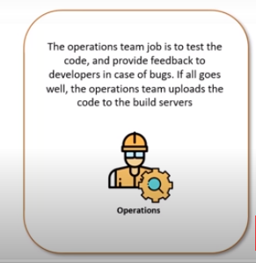

Slide 25
Docker/Kubernate –Containerization orcheistration platform
Puppet and ansible-configuration mgt
s/w testing –selenium
Integration –jenkins
Nagios-continuous monitoring

Slide 26
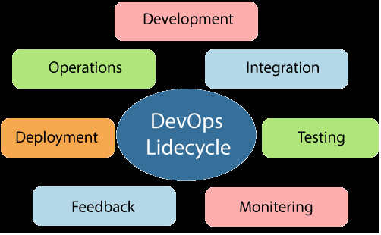
DevOps Lifecycle
DevOps defines an agile relationship between operations and Development. It is a process that is practiced by the development team and operational engineers together from beginning to the final stage of the product.
Learning DevOps is not complete without understanding the DevOps lifecycle phases. The DevOps lifecycle includes seven phases as given below:

Slide 27
Continuous development:This phase involves the planning and coding of the software. The vision of the project is decided during the planning phase. And the developers begin developing the code for the application. There are no DevOps tools that are required for planning, but there are several tools for maintaining the code.
Continuous Integration
This stage is the heart of the entire DevOps lifecycle. It is a software development practice in which the developers require to commit changes to the source code more frequently. This may be on a daily or weekly basis. Then every commit is built, and this allows early detection of problems if they are present. Building code is not only involved compilation, but it also includes unit testing, integration testing, code review, and packaging.The code supporting new functionality is continuously integrated with the existing code. Therefore, there is continuous development of software. Jenkins is a popular tool used in this phase. Whenever there is a change in the Git repository, then Jenkins fetches the updated code and prepares a build of that code, which is an executable file in the form of war or jar. Then this build is forwarded to the test server or the production server.

Slide 28
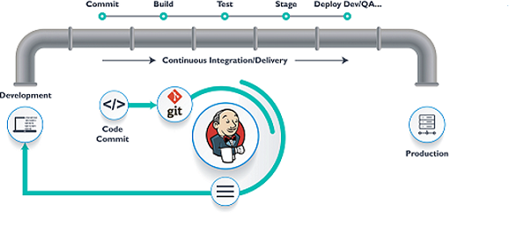

Slide 29
3) Continuous Testing
This phase, where the developed software is continuously testing for bugs. For constant testing, automation testing tools such as TestNG, JUnit, Selenium, etc are used
4) Continuous Monitoring
Monitoring is a phase that involves all the operational factors of the entire DevOps process, where important information about the use of the software is recorded and carefully processed to find out trends and identify problem areas. Usually, the monitoring is integrated within the operational capabilities of the software application.
5) Continuous Feedback
The application development is consistently improved by analyzing the results from the operations of the software. This is carried out by placing the critical phase of constant feedback between the operations and the development of the next version of the current software application.

Slide 30
6)Continuous Deployment
In this phase, the code is deployed to the production servers. Also, it is essential to ensure that the code is correctly used on all the servers.
et us try to understand a few things about Configuration management and Containerization tools. These set of tools here help in achieving Continuous Deployment (CD).
Configuration Management is the act of establishing and maintaining consistency in an application’s functional requirements and performance. There are several components in a configuration management system. Managed systems can include servers, storage, networking, and software. Let me put this in simpler words, it is the act of releasing deployments to servers, scheduling updates on all servers and most importantly keeping the configurations consistent across all the servers.
Since the new code is deployed on a continuous basis, configuration management tools play an important role in executing tasks quickly and frequently. Some popular tools that are used here are Puppet, Chef, SaltStack, and Ansible.
Containerization tools also play an equally important role in the deployment stage. Docker and Vagrant are the popular tools used for this purpose. These tools help produce consistency across Development, Test, Staging and Production environments. Besides this, they also help in scaling-up and scaling-down of instances swiftly.
Containerization tools help in maintaining consistency across the environments where the application is developed, tested and deployed. Using these tools, there is no scope of errors/ failure in the production environment as they package and replicate the same dependencies and packages used in the development/ testing/ staging environment. It makes your application easy to run on different computers.
Containerization is the process of packaging an application along with its required libraries, frameworks, and configuration files together so that it can be run in various computing environments efficiently. In simpler terms, containerization is the encapsulation of an application and its required environment.
Docker is a container management service. The keywords of Docker are develop, ship and run anywhere. The whole idea of Docker is for developers to easily develop applications, ship them into containers which can then be deployed anywhere.
7) Continuous Operations
All DevOps operations are based on the continuity with complete automation of the release process and allow the organization to accelerate the overall time to market continuingly.

Slide 31
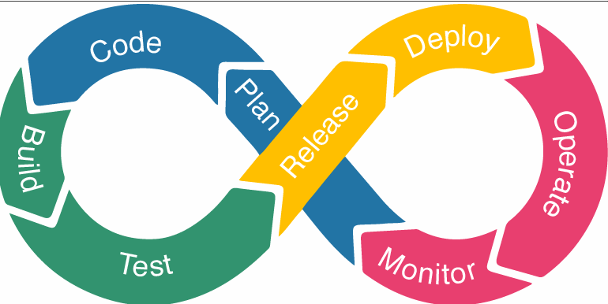

Slide 32
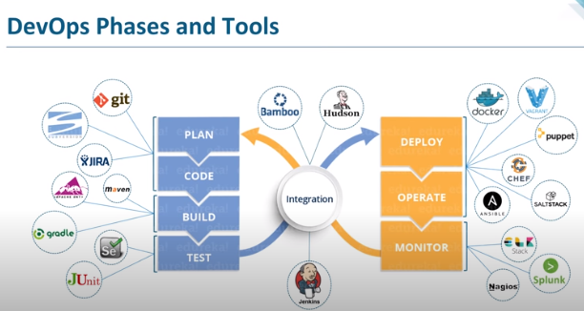

Slide 33
Ex, devloper devlopes some code for web app . We need to deploy it on application server to make it availible to the end user.
UI developer ,backend devloper,db developer .will keep their code at central location called as source code mgt tools.
Git—version controlling
Github-source code management tool
Convert code into artifact jar/war/rar format for this we need build tool such ant,gradle,maven etc
Artificate will be loated on server ex tomcat.
Automate the things we use jenkins

Slide 34
The tested build is deployed on production environment
Operation-using the software, to see the traffic, execution,
Monitoring the functionality ,if not send the feedback and again start from plainning. The popular tools used for this are Splunk, ELK Stack, Nagios, NewRelic and Sensu.
Life cycle is automated through tool.
Docker is a container management service. The keywords of Docker are develop, ship and run anywhere. The whole idea of Docker is for developers to easily develop applications, ship them into containers which can then be deployed anywhere.
Docker will give the tool to the op team.developer will put the code inside docker and oush it to the next phase.

Slide 35
PLANNING: requirement analysis
Code: code version management , source management. Tools used git, git hub
Build: compilation, validation, pkging unit testing, integration testing tool used maven ,gradle,ant etc.
Test: build application is deployed in test environment for testing such as unit , end user,function testing , selenium JUNit,
Deploy and operate: deployed on production environment.docker,puppet,chef etc.
Monitor-continous monitoring is done nagios,splunk
Integration:heart of devops,jenkins. integration:building the application continuously if it has changed.compliing,packaging . Jenkins.any changes in the code in shared repos , jenkins will pull the changes and build the changes . build will be deployed on test server.deploy it on prod server and then finally by tools such as nagios,Splunk

Slide 36
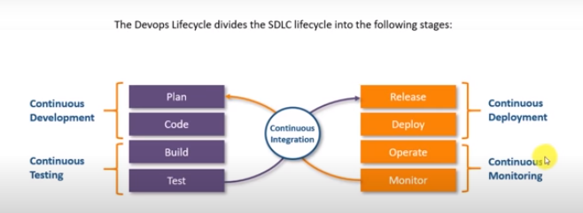

Slide 37
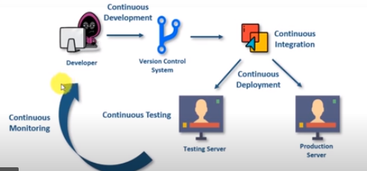

Slide 38
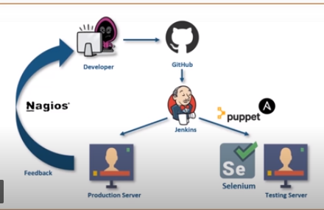

Slide 39
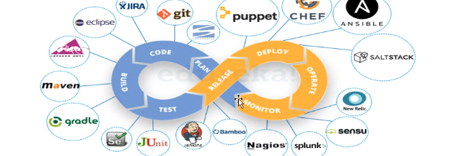

Slide 40
https://www.smartsheet.com/devops-tools

Slide 41
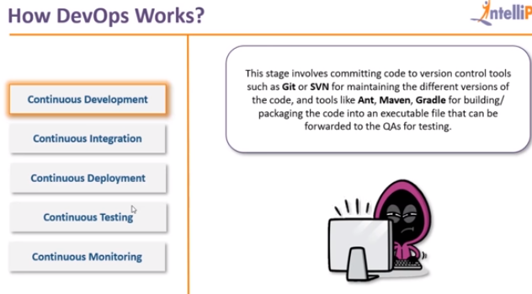

Slide 42
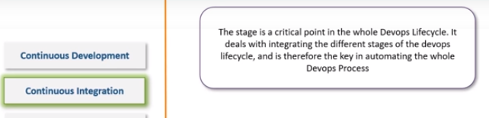

Slide 43
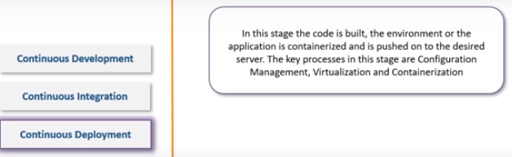

Slide 44
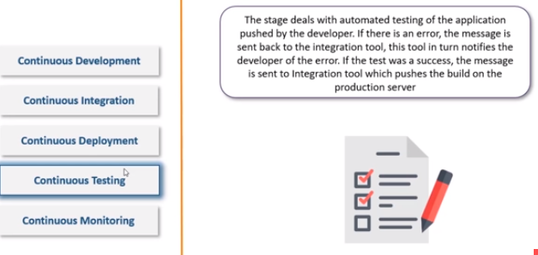

Slide 45
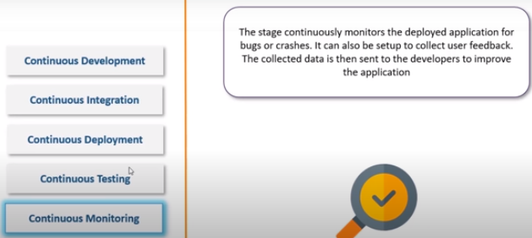

Slide 46
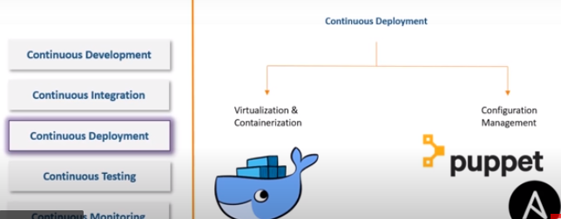

Slide 47
CON DEPLOYMENT –
Visualization & containerization:prb of sw running on differ platforms is solved by containerization, container will wrap the code with all.if we run the container on any sys it will run.container is the executable form of os
Conf mgt:puppet ansible,no need to install the sw if there is sw comatibility issue ,
Docker provides container

Slide 48
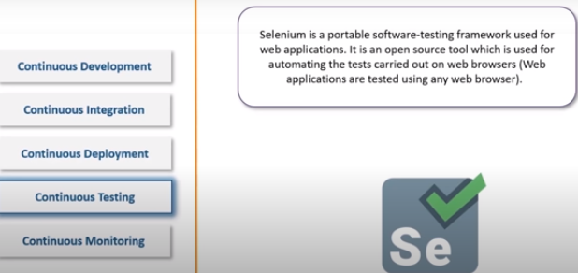

Slide 49
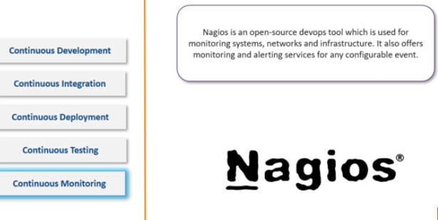

Slide 50
https://intellipaat.com/community/37506/what-are-the-stages-of-the-devops-lifecycle

Slide 51
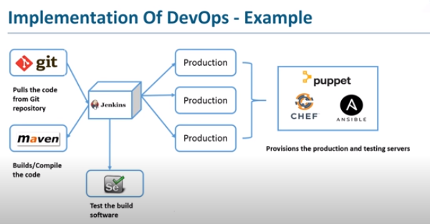

Slide 52
Test and prod server are manged by chef,puppet,ansible
https://www.javatpoint.com/devops-tools

Slide 53
Stages in devops
Version controlling—mutiple devloper is working on the same application to know abt the which dev has made which commit and at what time if any issue then how we will revert to the dev .managing the source code. Like git
Continuous integration:building the application continuously if it has changed.compliing,packaging . Jenkins
Continuois delivery Jenekins .build is deployed on test server for testing User acceptance testing for that we use tools like selenium for automation testing
Continuous deployment: Configuration mgt.

Slide 54
New code→continuous integration server will pull and make a build 1→2
2→3 build will be deployed on test server
3->4 continus deplyment
Monitor by continous monitiing tool such as nagios
Continous deployement is not advisable bcoz before releasing we want o do multiple checks , testing , we don’t want it shd be automated so we go for manual deployment tool such as puppet,docker ,chef etc.

Slide 55
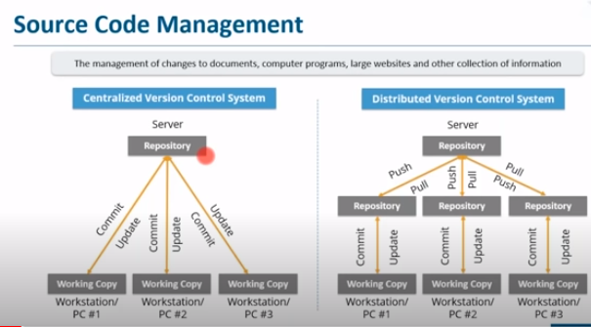
GIT

Slide 56
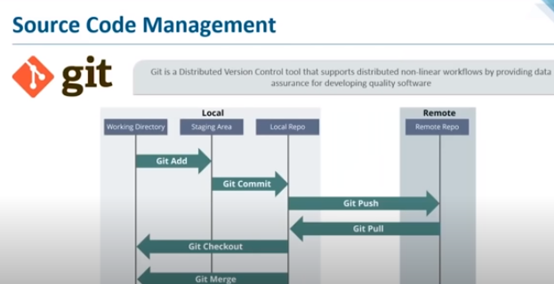

Slide 57
Git command
Git version
======Directory Command==================
mkdir <folder name>
cd <path of the directory>
=====--------------------------------------
Dell@Admin MINGW64 /g/ManishaGit
$ mkdir Myprojct
Dell@Admin MINGW64 /g/ManishaGit
$ cd Myprojct
Dell@Admin MINGW64 /g/ManishaGit/Myprojct
$
=========================================
To convert directory into local repository
Dell@Admin MINGW64 /g/ManishaGit/Myprojct
$ git init
=============================================

Slide 58
Add and Commit
----------------
create a file in Myprojct
example File1.txt
add some text in it
Now save the changes in staging error
Dell@Admin MINGW64 /g/ManishaGit/Myprojct (master)
$ git add File1.txt
will add the File1.txt to staging Area.

Slide 59
To add all files in the staging error use
-----------------------------------------------------
Dell@Admin MINGW64 /g/ManishaGit/Myprojct (master)
$ git add .
.-->Period
$git add File*
$ git status
To commit the files in Local Repository
---------------------------------------
Dell@Admin MINGW64 /g/ManishaGit/Myprojct (master)
$ git commit -m "First Commit"
[master (root-commit) 1aef2b1] First Commit
1 file changed, 1 insertion(+)
create mode 100644 File1.txt

Slide 60
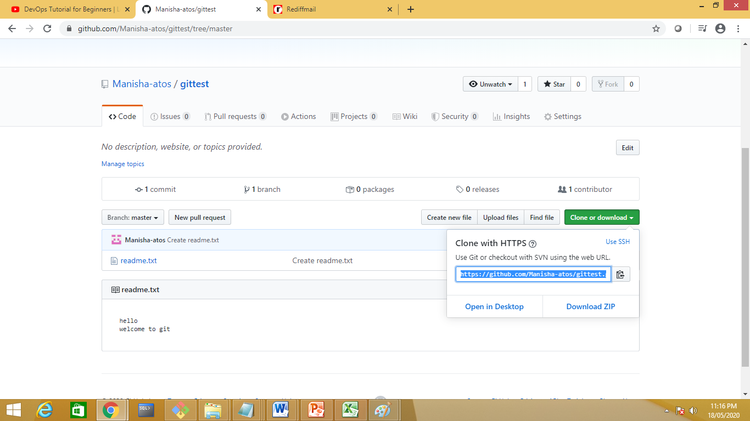

Slide 61
Dell@Admin MINGW64 /g/ManishaGit/test (master)
$ git remote add origin https://github.com/Manisha-atos/gittest.git
Will add the remote rep to locl repo

Slide 62
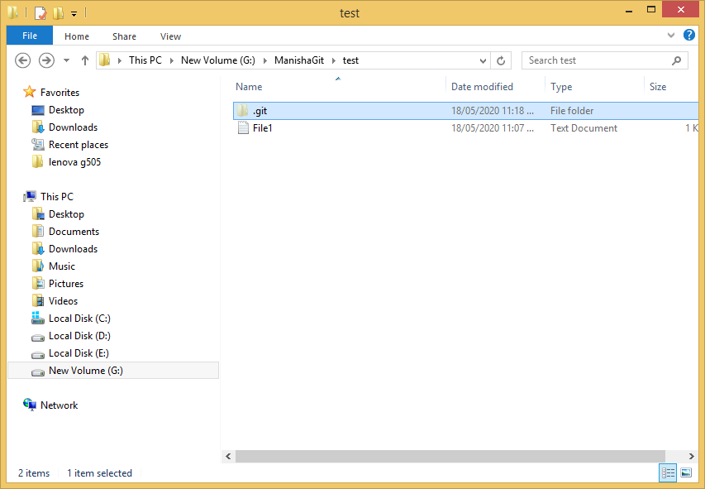

Slide 63
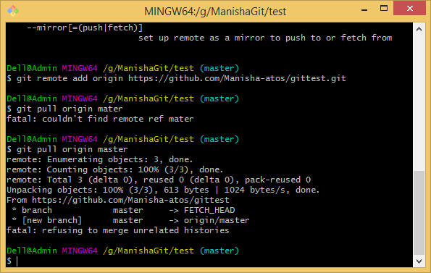
To pull from remote rep to local rep
$git pull origin master
git pull origin master --allow-unrelated-histories

Slide 64
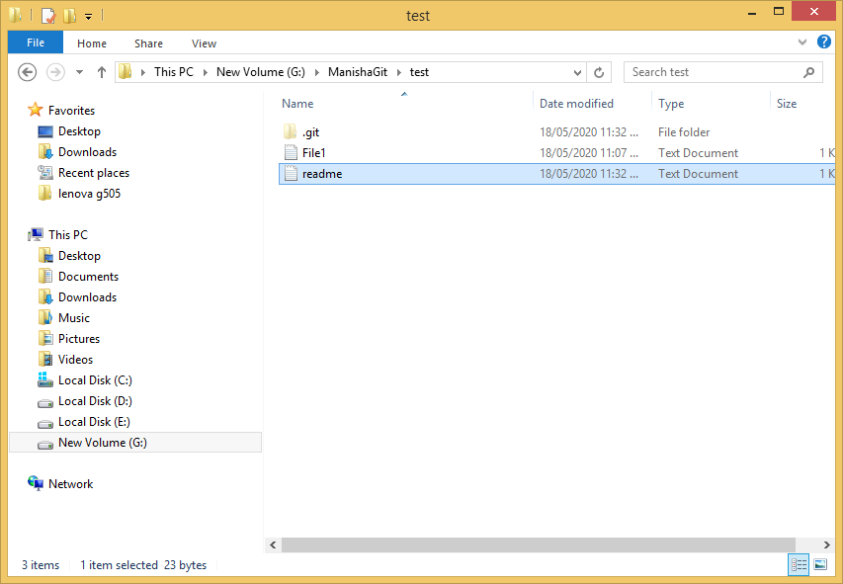

Slide 65
Local →Remote
$git push origin master

Slide 66
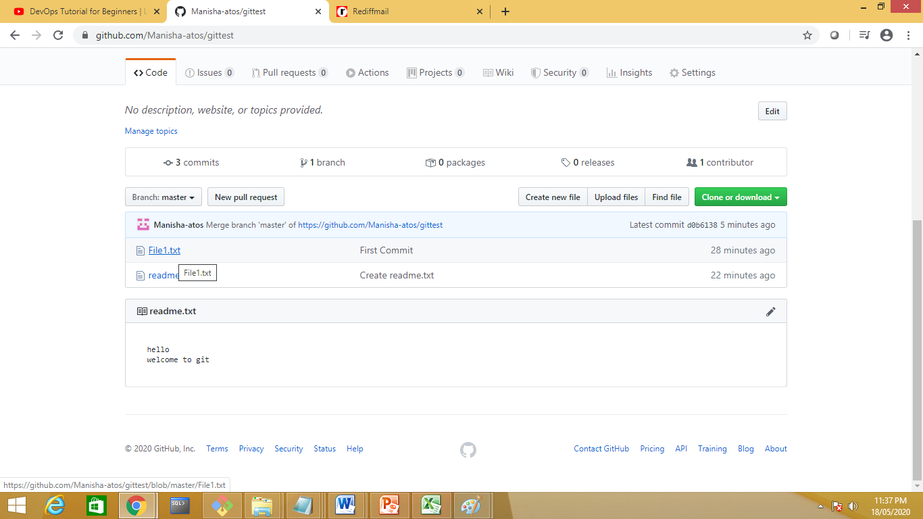

Slide 67
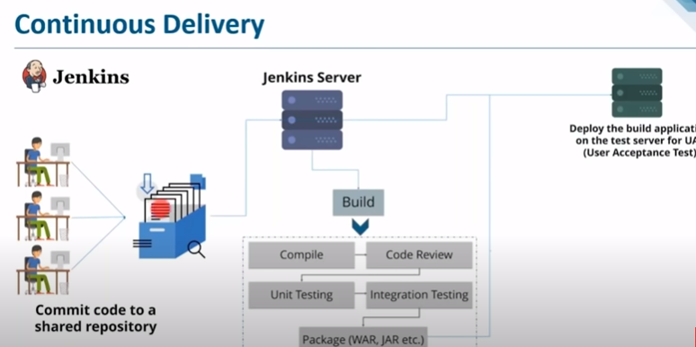

Slide 68
https://www.youtube.com/watch?v=hQcFE0RD0cQ

Slide 69
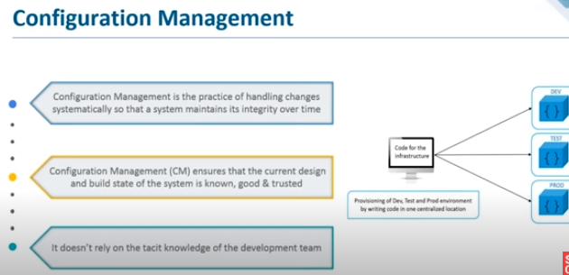

Slide 70
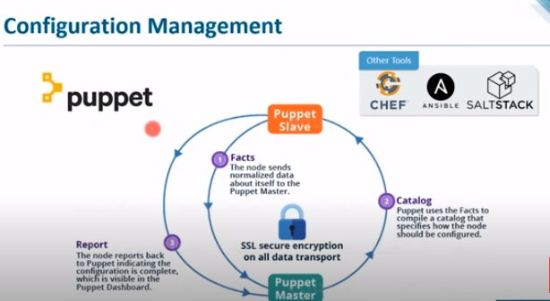

Slide 71
Apache Maven Command(software project mgt and compilation tool base on POM –project object model)
Dependency mgt system
mvn archetype:generate
-DgroupId = com.example
-DartifactId = calc
-DarchetypeArtifactId = maven-archetype-quickstart
-DinteractiveMode = false

Slide 72
MVN package: This command is used to execute all Maven phases until the package phase. It does the job of compiling, verifying and building the project. It builds the jar file and places it in the specified folder under the specified project.

Slide 73
mvn compile: This command is used to compile the source code. It also compiles the classes that are stored at a particular target or class.
mvn clean install: This maven command helps in executing a clean build life cycle and installs build phase in the default build cycle. This build life cycles may have its build phases and inside each build, there are different build goals. Also, this ensures that the build target is being removed for a new build and adds the clean target.

Slide 74
mvn test: Maven also provides the facility of unit testing particular codes. It runs the tests using suitable testing frameworks.

Slide 75
A Build Lifecycle is Made Up of Phases
Each of these build lifecycles is defined by a different list of build phases, wherein a build phase represents a stage in the lifecycle.
For example, the default lifecycle comprises of the following phases (for a complete list of the lifecycle phases, refer to the Lifecycle Reference):
validate - validate the project is correct and all necessary information is available
compile - compile the source code of the project
test - test the compiled source code using a suitable unit testing framework. These tests should not require the code be packaged or deployed
package - take the compiled code and package it in its distributable format, such as a JAR.
verify - run any checks on results of integration tests to ensure quality criteria are met
install - install the package into the local repository, for use as a dependency in other projects locally

Slide 76
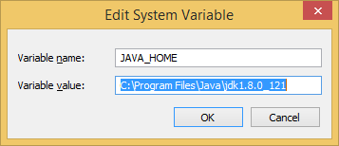
Set JAVA_HOME to C:\Program Files\Java\jdk1.7.0_60

Slide 77
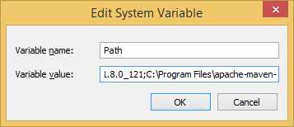
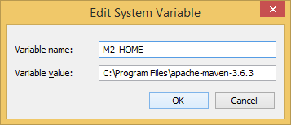
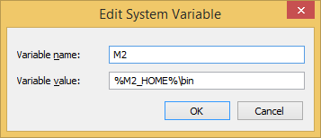
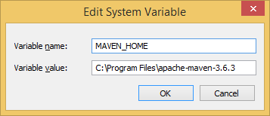
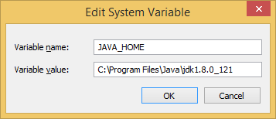
Set Maven Environment Variables

Slide 78
Mvn –v
Create
Mvn pac
Mvn clean install
Mvn validate
Mvn compile
Mvn build
Mvn test

Slide 79
Jenkins
2 ways to run Jenkins
Standalone
With web server such as tomcat
https://updates.jenkins-ci.org/download/war/
standalone installation
1.download Jenkins file
for standalone we need jdk1.8
for tomcat any version
2.copy pate it in drive
3. start a cmd and run the command
Java –jar Jenkins.war

Slide 80
Introduction to Jenkins

Slide 81
Java –jar Jenkins.war --httpPort=9090
Manisha Jenkins pwd
https://www.guru99.com/jenkins-github-integration.html

Slide 82
Check for th github plugin in jenkins
Git integration
Github integartion
Maven integration
Githubapi

Slide 83
Create a new gitcmd job to excute the git command

Slide 84
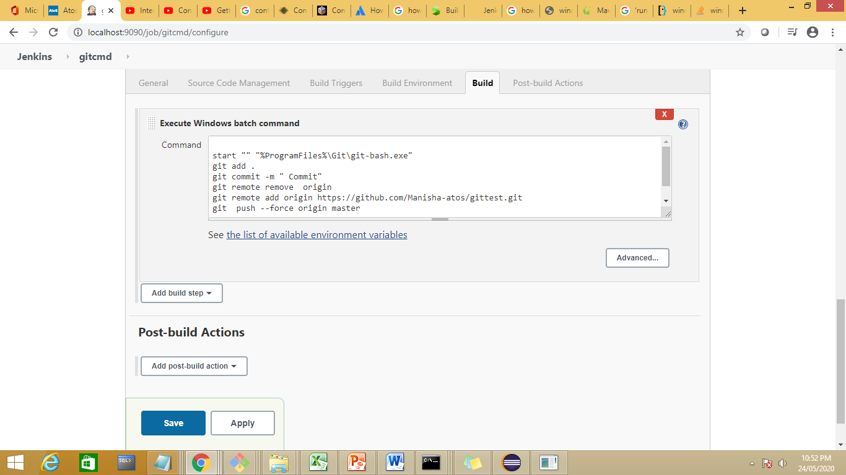

Slide 85
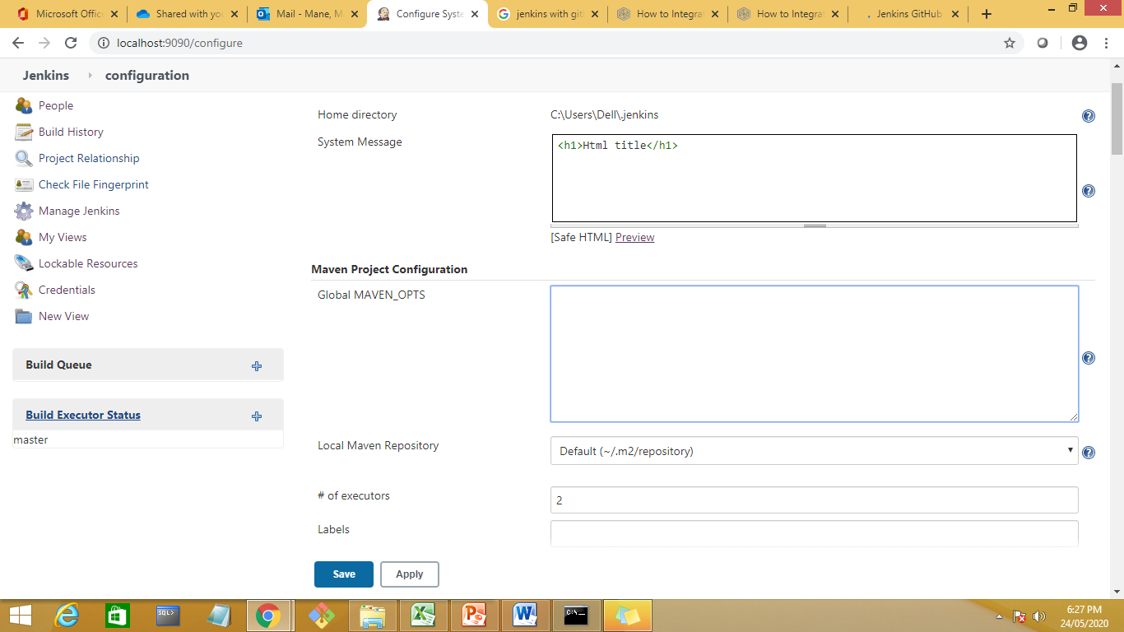

Slide 86
Create a new job to push the data from remote repositry to jenkins

Slide 87
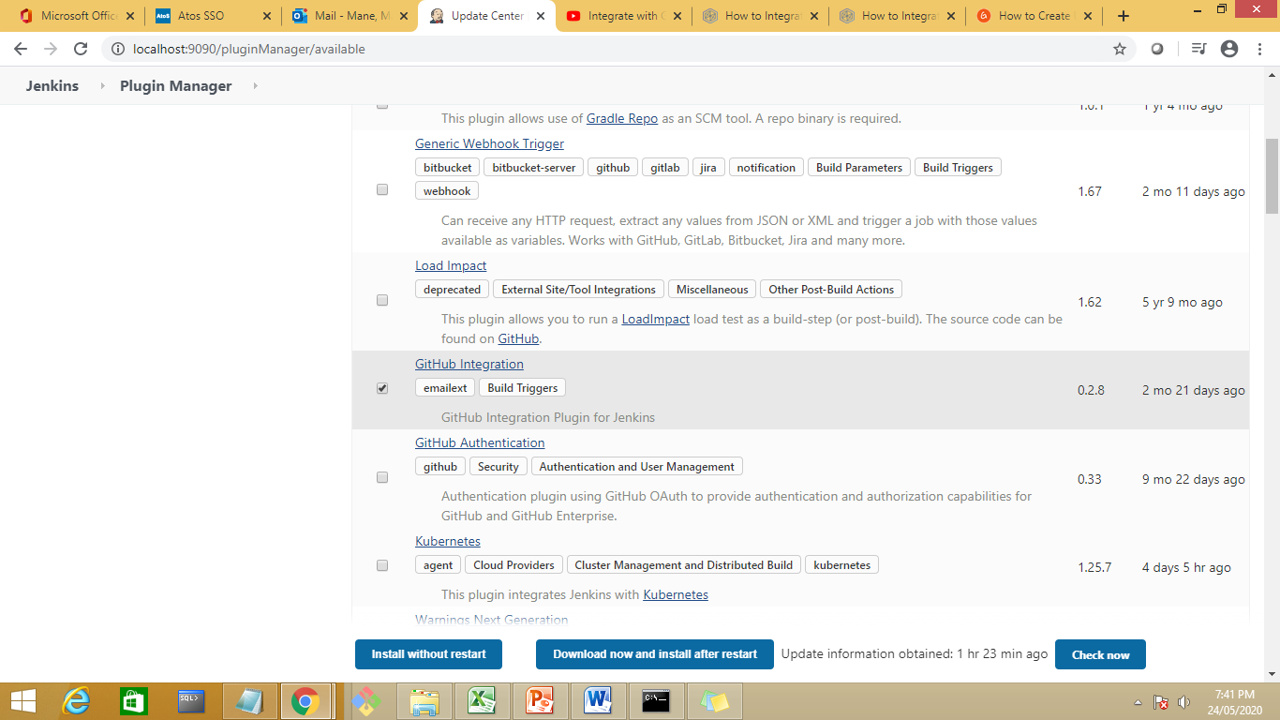

Slide 88
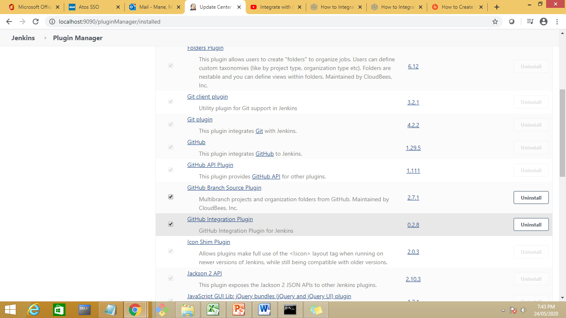

Slide 89
Download now and install now if not available
Install git plugin
Restart the jenkins

Slide 90
Code management from git to jenkins.
Create a new job

Slide 91
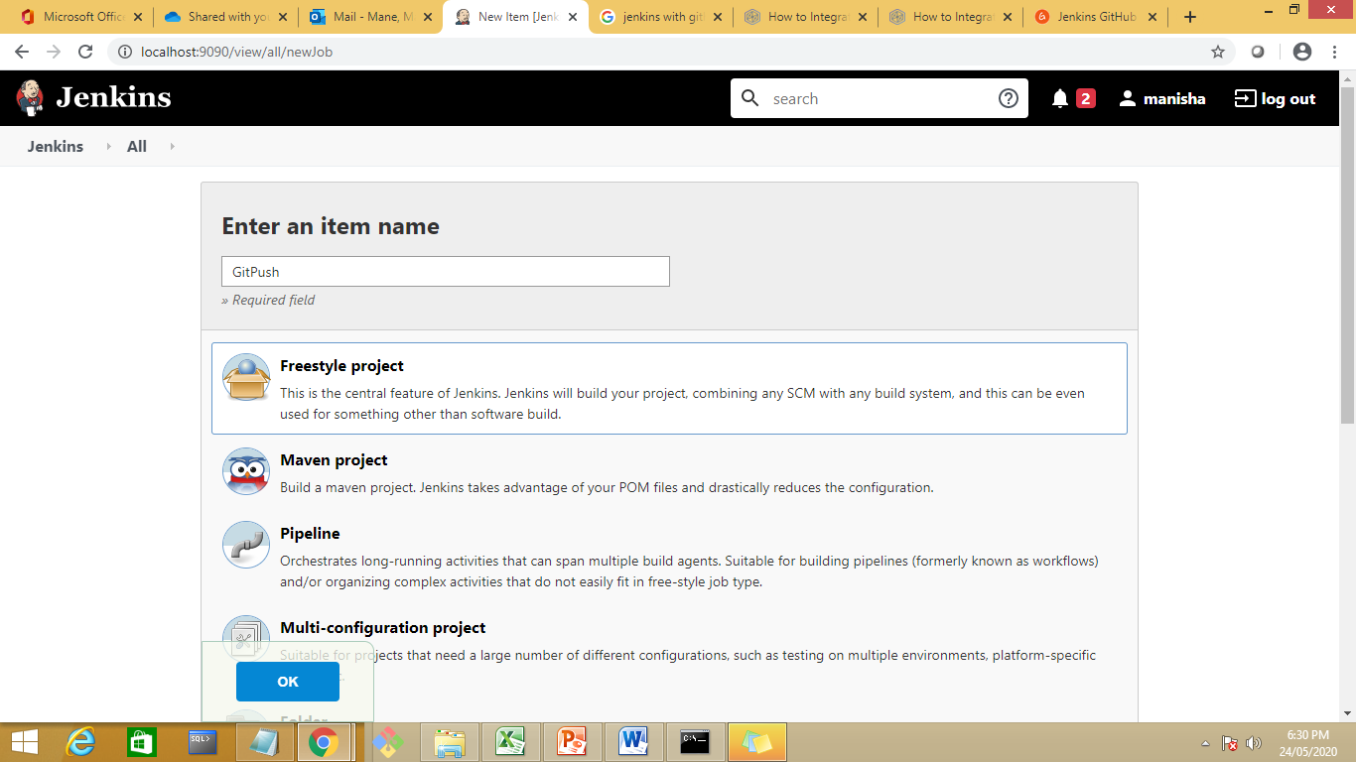

Slide 92
In the screen you see now, scroll down a little to the Build Triggers section. We're going to make sure that this Jenkins job runs only when someone pushes a change in the GitHub repo. You can configure other actions, like when someone creates a pull request. But for simplicity's sake, we'll stick with the push action only. Of course, you can always run the job manually, but that's not ideal. So, choose the GitHub hook trigger for GITScm polling option.

Slide 93
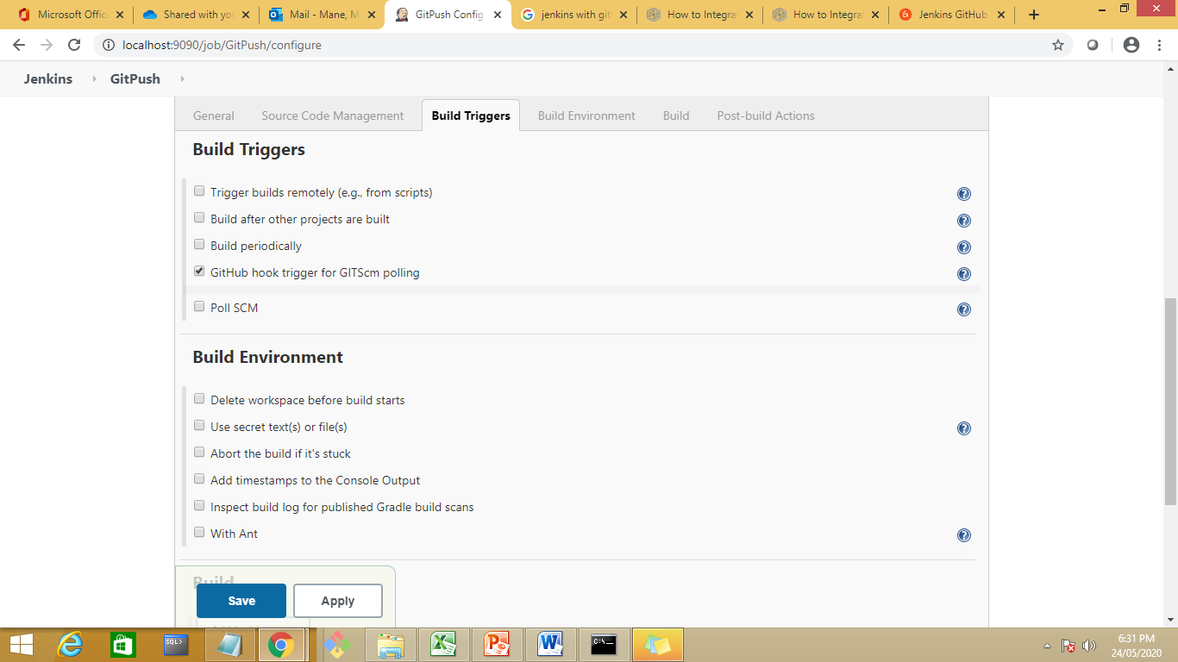

Slide 94
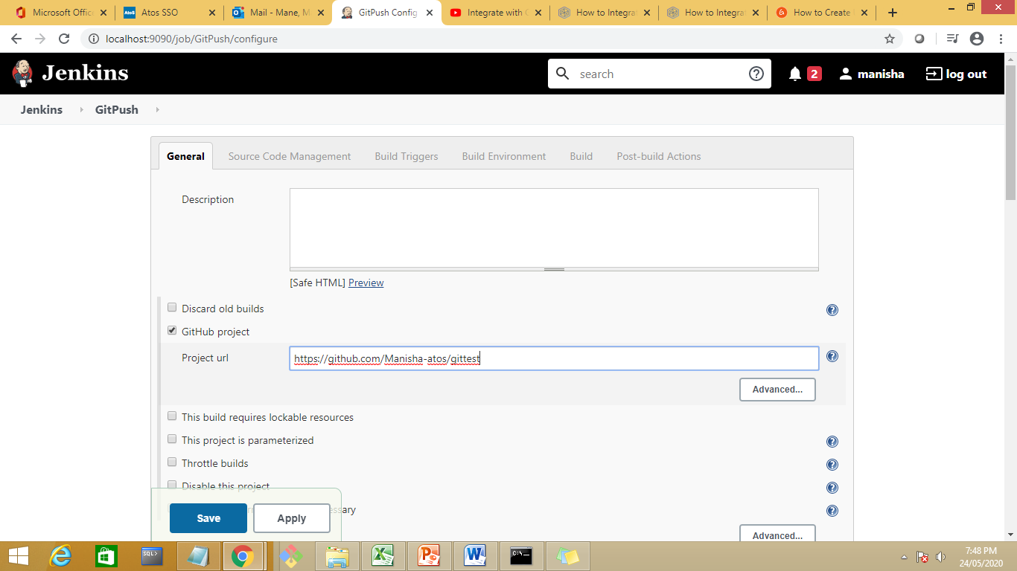

Slide 95
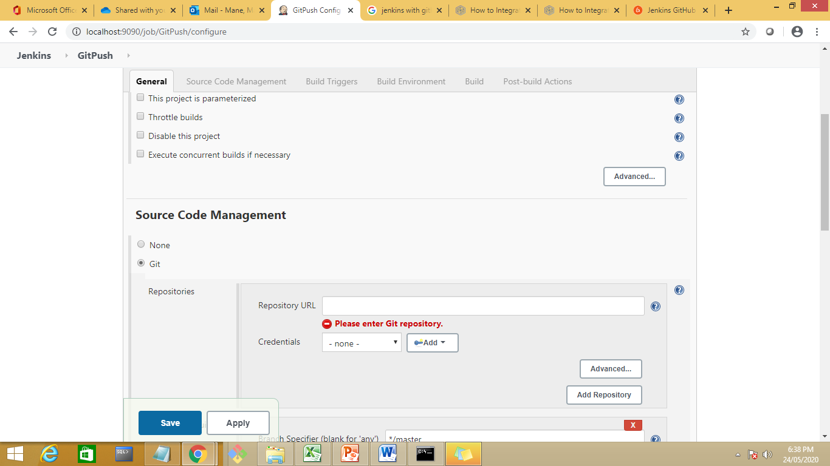

Slide 96
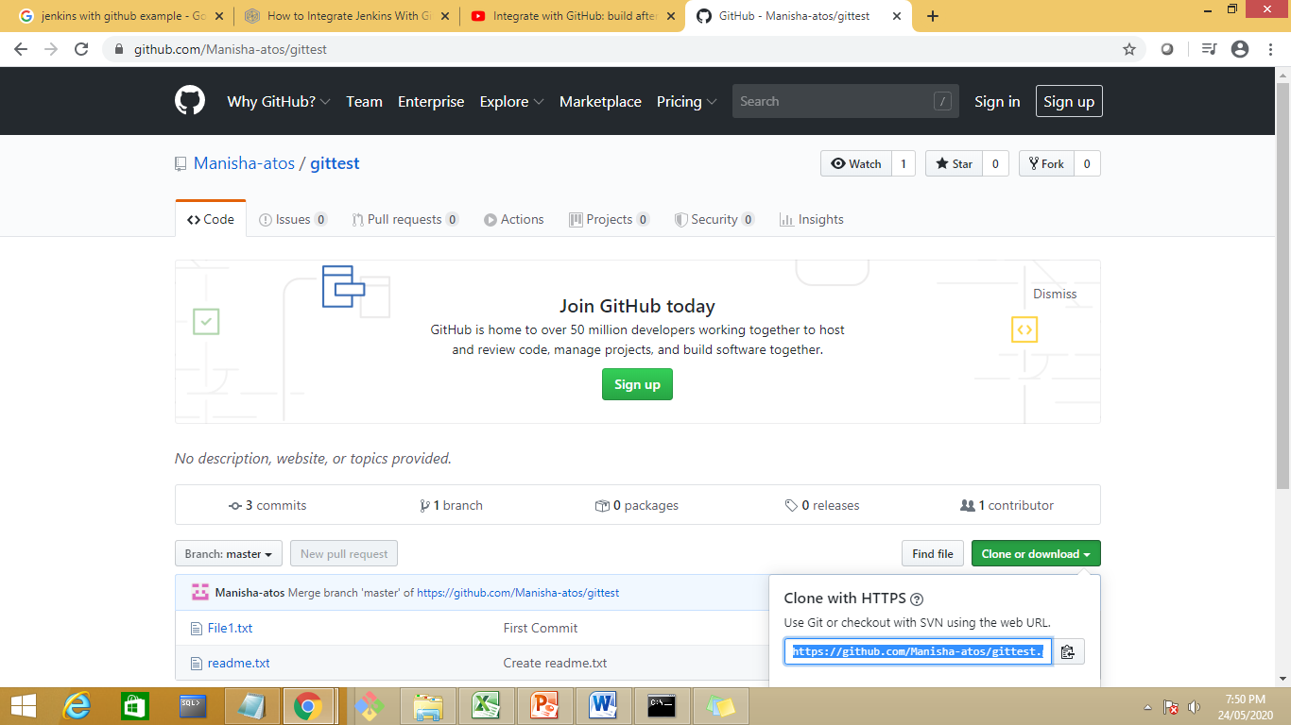

Slide 97


Slide 98
SPECIFY THE BRANCH default is master.
Build trigger-specify an event whoch will notify jenkins when to start push with github

Slide 99


Slide 100


Slide 101
Save the job

Slide 102
To tell gihub abt jenkins go to repository
Github repository→settings →webhook→Add webhook

Slide 103


Slide 104


Slide 105


Slide 106

Chanhe local host to ip address

Slide 107
Add webhook

Slide 108
Do some changes in repos

Slide 109


Slide 110
Add new file in repository as FIle3.txt
Commit the changes and build the jenkins job

Slide 111


Slide 112
Jenkins with Maven
https://www.google.com/search?rlz=1C1OKWM_enIN897IN897&biw=1366&bih=657&ei=5pXKXtfQDYrXz7sP5-Kx4A4&q=how+to+use+git+add+command+in+jenkins&oq=how+to+use+git+add+command+in+j&gs_lcp=CgZwc3ktYWIQARgAMggIIRAWEB0QHjIICCEQFhAdEB4yCAghEBYQHRAeMggIIRAWEB0QHjoFCAAQkQI6BQgAEIMBOgIIADoECAAQQzoECAAQCjoGCAAQFhAeUKamAViW2QFgl-0BaABwAHgAgAHCAYgB7xWSAQQxLjIymAEAoAEBqgEHZ3dzLXdpeg&sclient=psy-ab#kpvalbx=_LJbKXvjPIsfXz7sP9LutwAo54

Slide 113


Slide 114
Create a new project

Slide 115


Slide 116


Slide 117
Create a new job as maven project

Slide 118


Slide 119
Jenkins-manage plugin-global tool configuration--

Slide 120
Create a maven project

Slide 121


Slide 122


Slide 123


Slide 124


Slide 125
Select the path of pom.xml file

Slide 126
https://www.javatpoint.com/github-setup-for-jenkins

